Slide 1
CRT Meeting 12-3-2015
Farm Out estimating of new finished goods and adding estimate numbers to existing finished goods

Slide 2
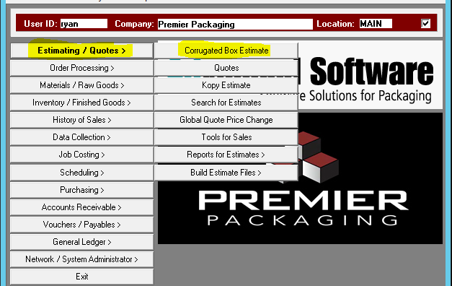
Adding new estimates
To begin, use hot keys E-C for Estimating-Corrugated box estimates.

Slide 3
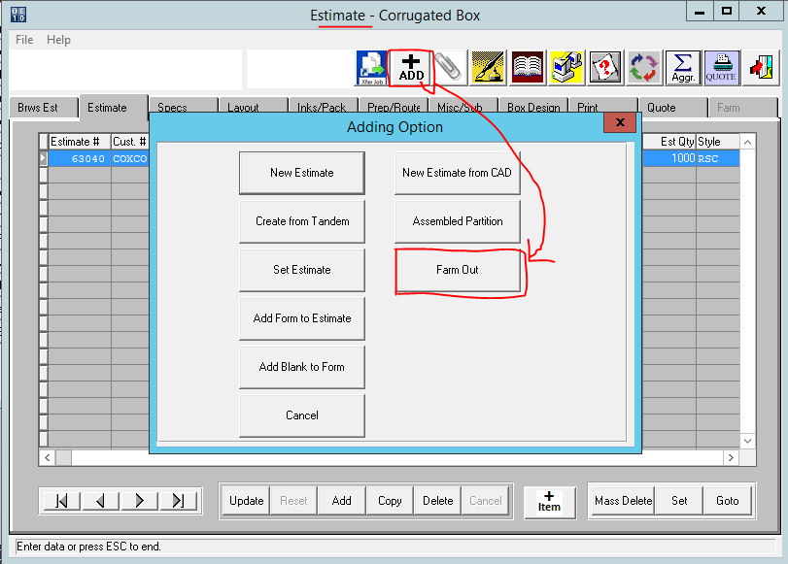
Adding new estimates
To create a new estimate whether it is manufactured in house or bought it, click the add button at the top
For items that are going to be bought out, click the Farm Out button.

Slide 4
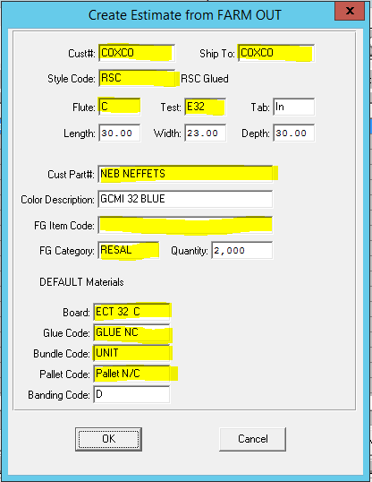
Creating your estimate
You will be prompted for info needed to create an estimate from your current bought out item or future bought out item.
All fields in yellow have a F1 look up available.
If creating an estimate for an EXISTING item you would enter the item FG # in the field marked FG Item Code. Otherwise leave blank.

Slide 5
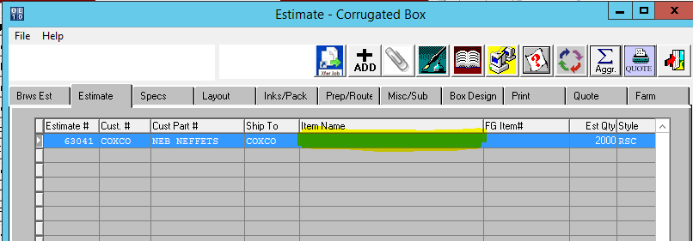
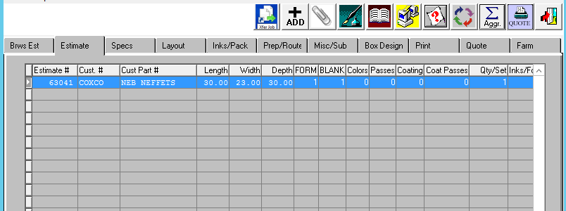
Creating your estimate
After entering all the item specs, you will be taken to the estimate screen. Here you will see that everything you have entered has been auto filled.
You will only need to enter the Item Name on this screen. As you tab through, you will see that all fields such as length, width and depth have all been filled in.

Slide 6
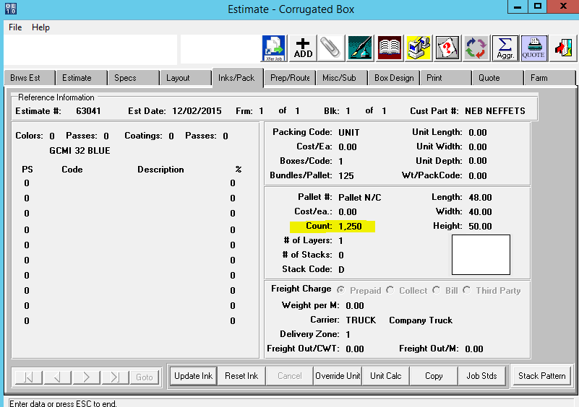
Creating your estimate
On the Inks/Pack page you have the ability to change the staking patterns as well as unitizing. Always make sure the count is entered correctly.
You also have the ability to add the freight terms as well.

Slide 7
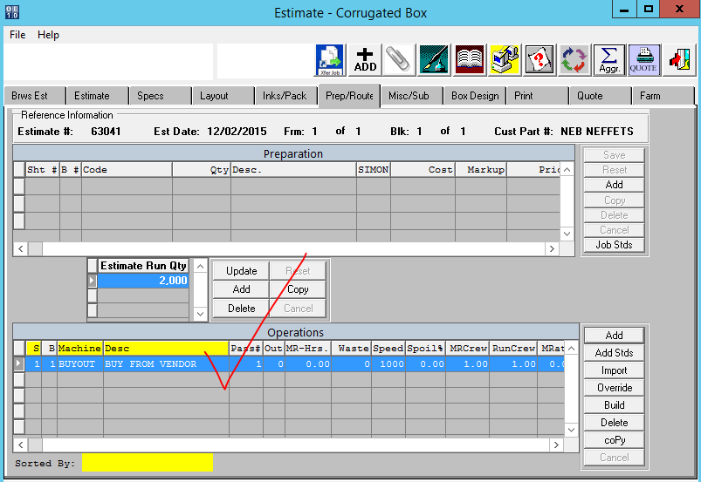
Creating your estimate
Since it’s a buyout, your machine under prep/routing will be buy out from vendor

Slide 8
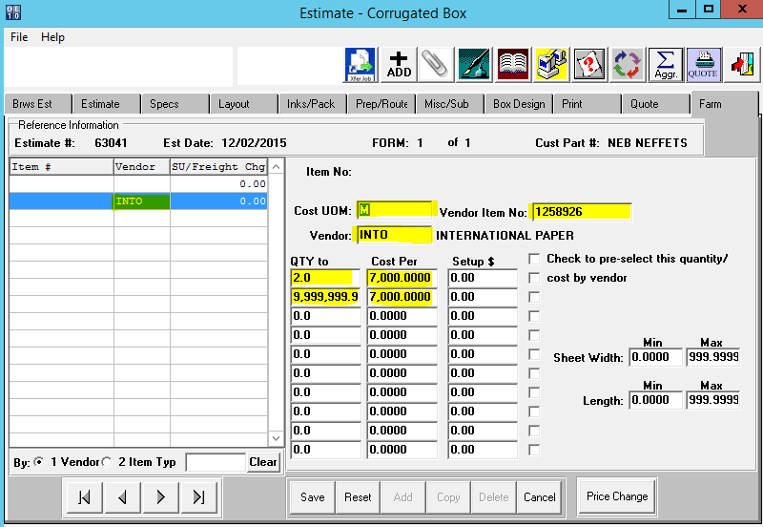
Pricing your farmed out estimate
Under the Farm tab is where you would add your cost for the item. Cost unit of measure with be M per thousand or EA per each. In the example it’s per thousand, M.
Our vendor quoted us $7,0000 per 2,000 ordered.
*It’s absolutely mandatory that you enter the last QTY to field as all 9’s or else it will skew your costing.

Slide 9
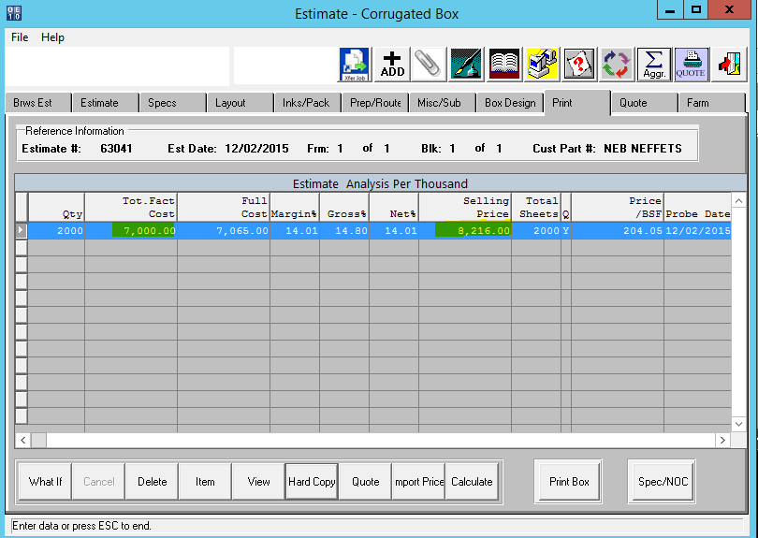
Pricing your farmed out estimate
After entering your vendor costs, you would go to the Print tab and press the calculate button at the bottom of the screen. This is going to import in your vendor’s quoted price along with company overhead and add in profit margin.
In the example, the vendor quoted us $7,000, so after everything is added on our side along with a 14% profit margin, we would quote our customer at $8,216.00

Slide 10
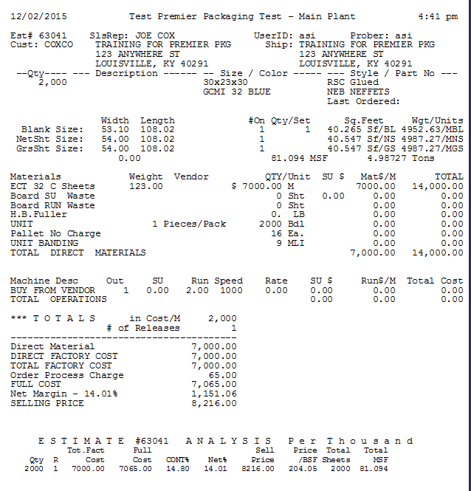
Printing your farmed out estimate
On the Print tab, at the bottom there is a tab that says Hard Copy. Clicking this will bring up the hard copy of your estimate braking down all costs.

Slide 11
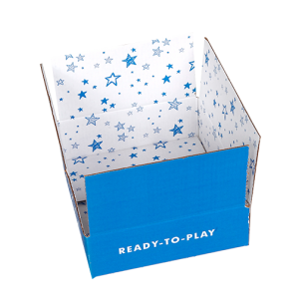
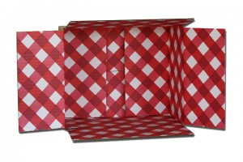
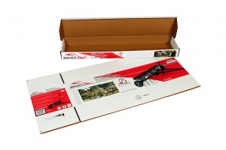
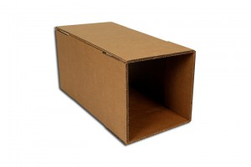
Finishing your new estimate
If your item already had a FG # associated with it, you are done and it now has an estimate number associated with it.
If this is a new quote to the customer that has not been realized yet, you would either come back and add the FG once a PO has been issued by our customer or leave it as an estimate.

